Slide 1
Lec 10: SOFTWARE ENGINEERING
GE-100
Application of Information and Communication Technologies
Instructor: Alina Maryum

Slide 2
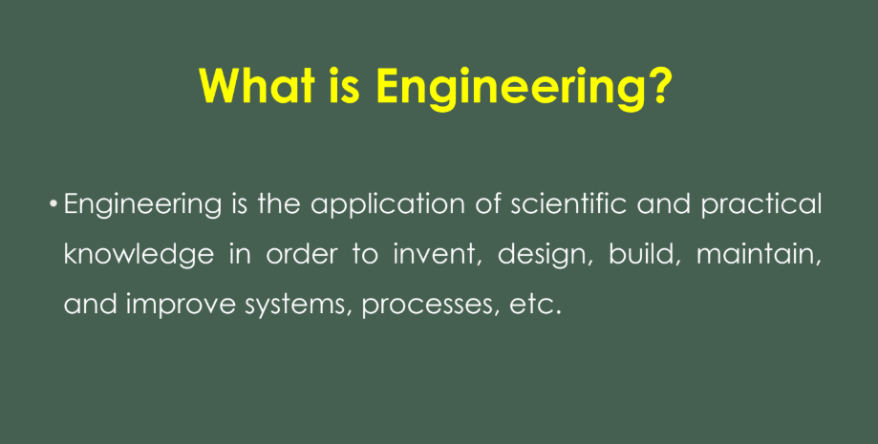

Slide 3
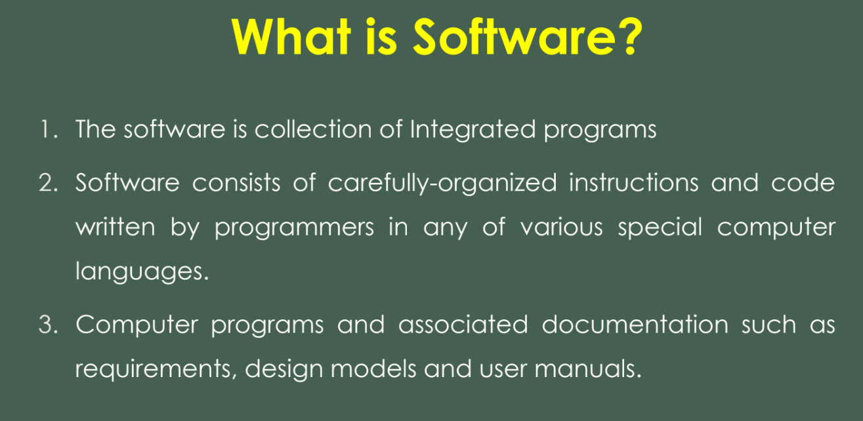

Slide 4
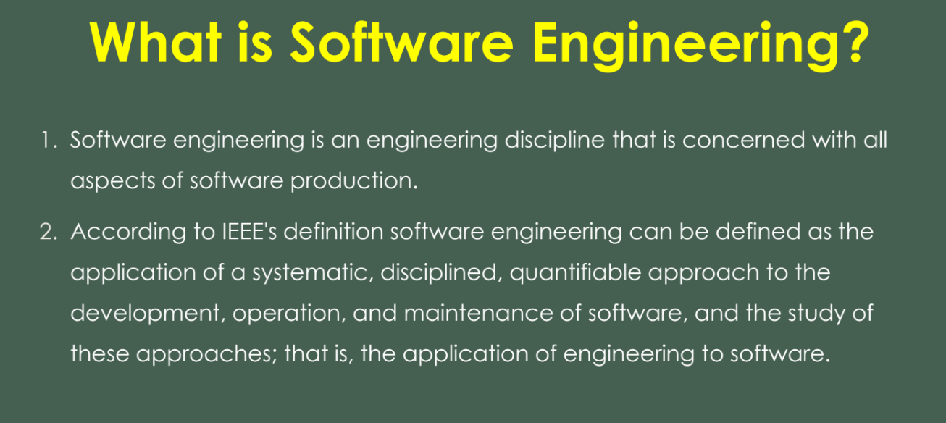

Slide 5
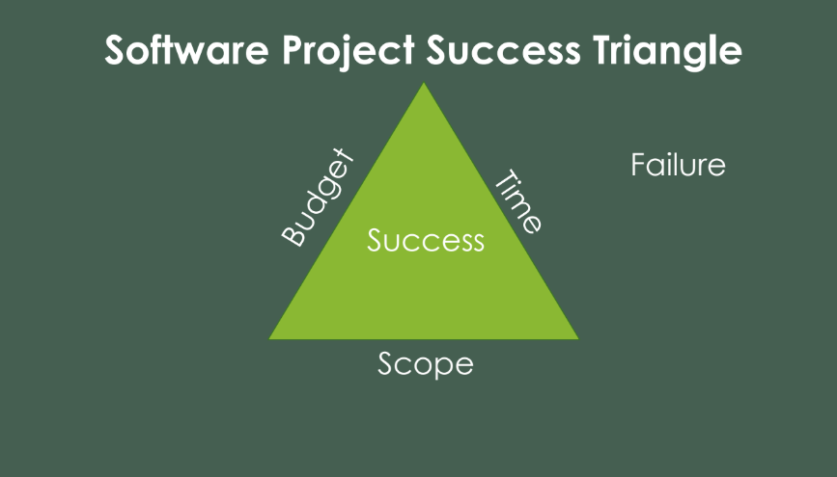

Slide 6
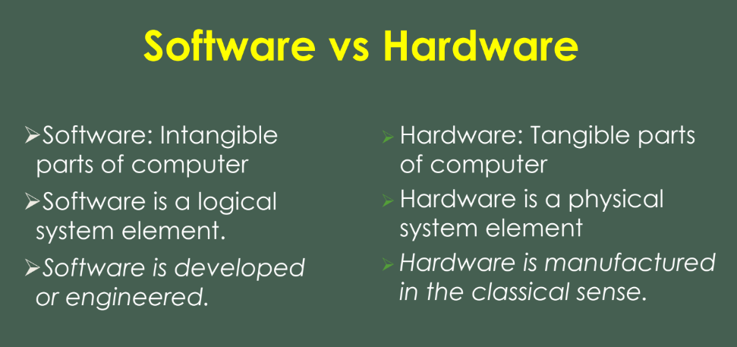

Slide 7
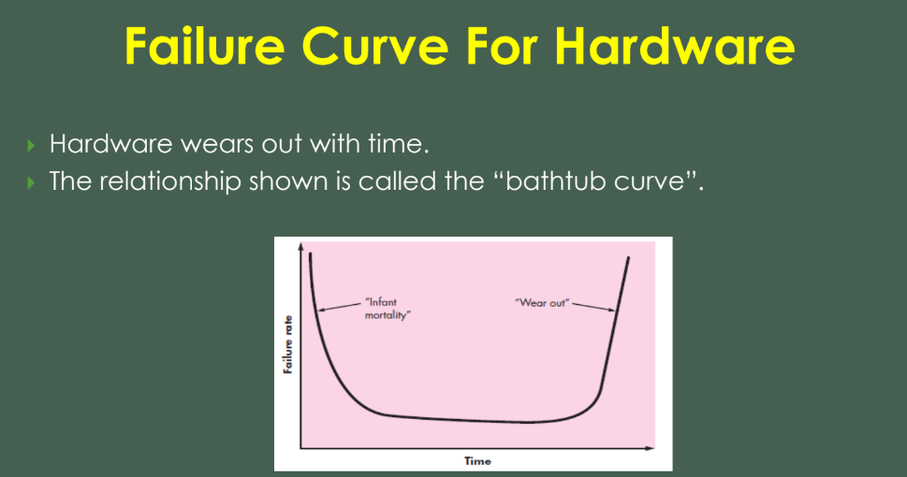

Slide 8
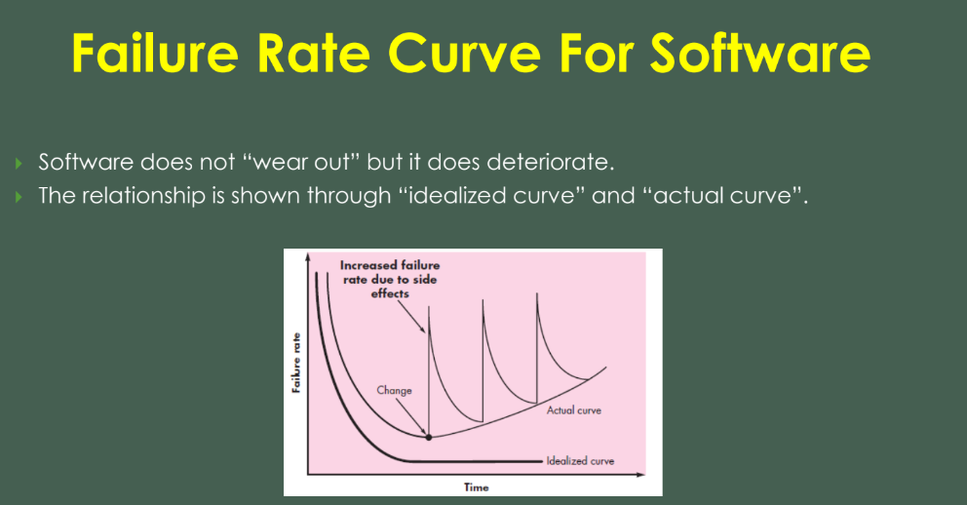

Slide 9
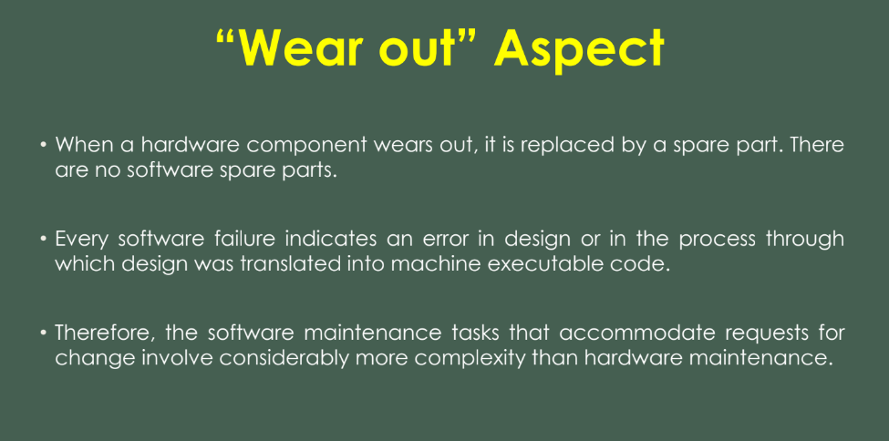

Slide 10
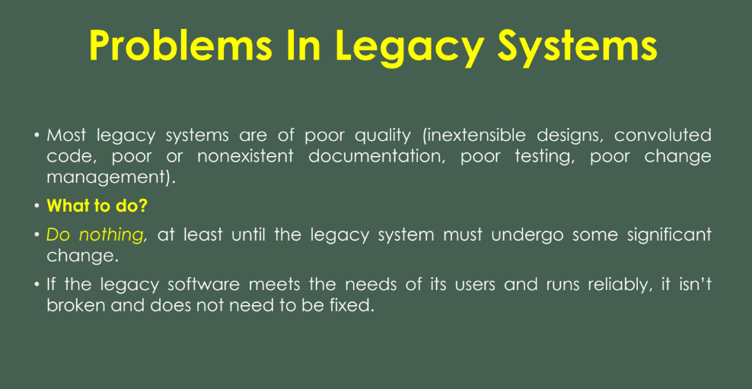

Slide 11
Legacy Software
“Legacy software can be characterized informally as old software that is still performing a useful job for the community.”
Legacy software systems are programs that are still well used by the community or have some potential inherent value but that were developed years ago using early versions of Fortran or other languages.

Slide 12
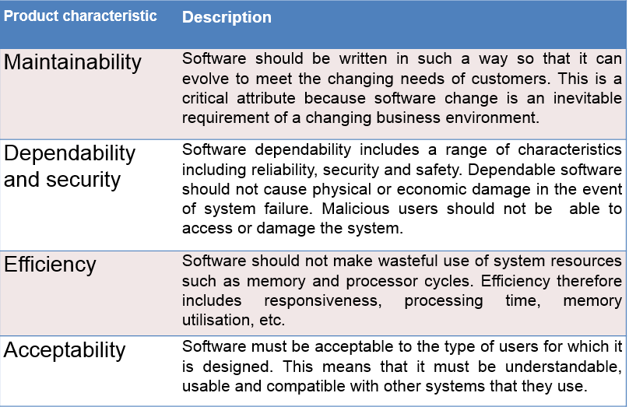
Attributes of Good Software

Slide 13
Software Process
A framework that describes the activities performed at each stage of a software development project. A set of activities whose goal is the development or evolution of software.
Generic activities in all software processes are:
Specification - what the system should do and its development constraints
Development - production of the software system
Validation - checking that the software is what the customer wants
Evolution - changing the software in response to changing demands.

Slide 14
Software Development Life Cycle
Software Development Life Cycle (SDLC) is a process used by the software industry to design, develop and test high quality softwares. The SDLC aims to produce a high-quality software that meets or exceeds customer expectations, reaches completion within times and cost estimates.
SDLC is the acronym of Software Development Life Cycle.
It is also called as Software Development Process.
SDLC is a framework defining tasks performed at each step in the software development process.
ISO/IEC 12207 is an international standard for software life-cycle processes. It aims to be the standard that defines all the tasks required for developing and maintaining software.

Slide 15
What is SDLC?
SDLC is a process followed for a software project, within a software organization.
It consists of a detailed plan describing how to develop, maintain, replace and alter or enhance specific software.
The life cycle defines a methodology for improving the quality of software and the overall development process.

Slide 16
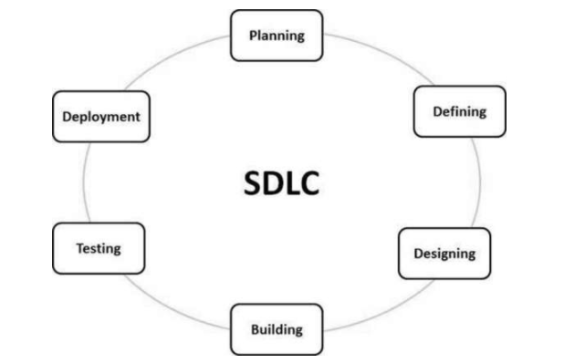
The following figure is a graphical representation of the various stages of a typical SDLC.

Slide 17
Stage 1: Planning and Requirement Analysis
Requirement analysis is the most important and fundamental stage in SDLC. It is performed by the senior members of the team with inputs from the customer, the sales department, market surveys and domain experts in the industry.
This information is then used to plan the basic project approach and to conduct product feasibility study in the economical, operational and technical areas.
Planning for the quality assurance requirements and identification of the risks associated with the project is also done in the planning stage.
The outcome of the technical feasibility study is to define the various technical approaches that can be followed to implement the project successfully with minimum risks.

Slide 18
Stage 2: Defining Requirements
Once the requirement analysis is done the next step is to clearly define and document the product requirements and get them approved from the customer or the market analysts.
This is done through an SRS (Software Requirement Specification) document which consists of all the product requirements to be designed and developed during the project life cycle.

Slide 19
Stage 3: Designing the Product Architecture
Based on the requirements specified in SRS, usually more than one design approach for the product architecture is proposed and documented in a DDS - Design Document Specification.
This DDS is reviewed by all the important stakeholders and based on various parameters as risk assessment, product robustness, design modularity, budget and time constraints, the best design approach is selected for the product.
A design approach clearly defines all the architectural modules of the product along with its communication and data flow representation with the external and third party modules (if any).
The internal design of all the modules of the proposed architecture should be clearly defined with the minutest of the details in DDS.
Notes:
A stakeholder has a vested interest in a company and can either affect or be affected by a business' operations and performance.
Typical stakeholders are investors, employees, customers, suppliers, communities, governments, or trade associations.

Slide 20
Stage 4: Building or Developing the Product
In this stage of SDLC the actual development starts and the product is built. The programming code is generated as per DDS during this stage
Developers must follow the coding guidelines defined by their organization and programming tools like compilers, interpreters, debuggers, etc. are used to generate the code.
Different high level programming languages such as C, C++, Pascal, Java and PHP are used for coding. The programming language is chosen with respect to the type of software being developed.

Slide 21
Stage 5: Testing the Product
This stage is usually a subset of all the stages as in the modern SDLC models, the testing activities are mostly involved in all the stages of SDLC.
However, this stage refers to testing of the product where product defects are reported, tracked, fixed and retested, until the product reaches the quality standards defined in the SRS.

Slide 22
Stage 6: Deployment in the Market and Maintenance
Once the product is tested and ready to be deployed it is released formally in the appropriate market.
The product may first be released in a limited segment and tested in the real business environment (UAT- User acceptance testing).
Then based on the feedback, the product may be released as it is or with suggested enhancements in the targeting market segment.
After the product is released in the market, its maintenance is done for the existing customer base.

Slide 23
SDLC SUMMARY
https://www.youtube.com/watch?v=i-QyW8D3ei0

Slide 24
Software Development Models
There are various software development life cycle models defined and designed which are followed during the software development process.
These models are also referred as Software Development Process Models". Each process model follows a Series of steps unique to its type to ensure success in the process of software development.
The software development models are the various processes or methodologies that are being selected for the development of the project depending on the project’s aims and goals.
Notes:
There are many development life cycle models that have been developed in order to achieve different required objectives.
The models specify the various stages of the process and the order in which they are carried out.

Slide 25
Software Development Models
Following are the most important and popular SDLC models followed in the industry −
Waterfall Model
Iterative Model
Spiral Model
V-Model
Big Bang Model
Other related methodologies are Agile Model, RAD Model, Rapid Application Development and Prototyping Models.

